Slide 1
Relational Database Design

Slide 2
Relational Database Design
First Normal Form
Pitfalls in Relational Database Design
Functional Dependencies
Decomposition
Boyce-Codd Normal Form
Third Normal Form
Multivalued Dependencies and Fourth Normal Form
Overall Database Design Process

Slide 3
First Normal Form
Domain is atomic if its elements are considered to be indivisible units
Examples of non-atomic domains:
Set of names, composite attributes
Identification numbers like CS101 that can be broken up into parts
Ii requires extra programming
If such identification numbers are used as primary keys
When an employee changes department
The employee’s identification number must be changed

Slide 4
First Normal Form
A relational schema R is in first normal form if the domains of all attributes of R are atomic
Non-atomic values complicate storage and encourage redundant (repeated) storage of data
E.g. Set of accounts stored with each customer, and set of owners stored with each account
We assume all relations are in first normal form

Slide 5
In a onference paper by Edgar Codd, 1971
A character string would seem not to be atomic, as the RDBMS typically provides operators to decompose it into substrings.
A fixed-point number would seem not to be atomic, as the RDBMS typically provides operators to decompose it into integer and fractional components.
An ISBN would seem not to be atomic, as it includes language and publisher identifier.

Slide 6


Slide 7
First Normal Form

Slide 8
Pitfalls in Relational Database Design
Relational database design requires that we find a “good” collection of relation schemas. A bad design may lead to
Repetition of Information.
Inability to represent certain information.
Design Goals:
Avoid redundant data
Ensure that relationships among attributes are represented
Facilitate the checking of updates for violation of database integrity constraints.

Slide 9
When we design a relational database: We first list those functional dependencies that must always hold. In the banking example List of dependencies includes:

Slide 10
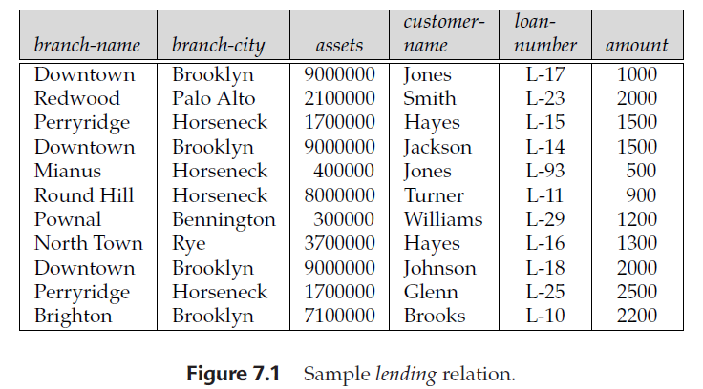
Update:
(Perryridge, Horseneck, 1700000, Adams, L-31, 1500)

Slide 11
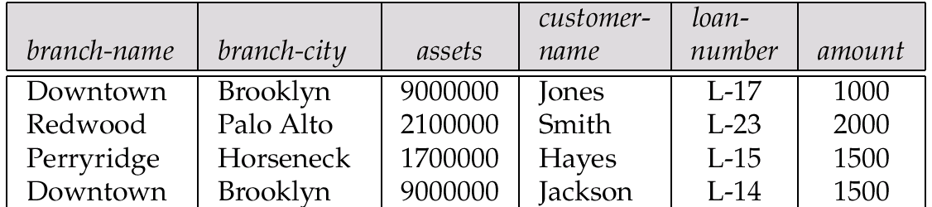
Example
Consider the relation schema: Lending-schema = (branch-name, branch-city, assets, customer-name, loan-number, amount)

Slide 12
Example
Consider the relation schema: Lending-schema = (branch-name, branch-city, assets, customer-name, loan-number, amount)
Redundancy:
Data for branch-name, branch-city, assets are repeated for each loan that a branch makes
Wastes space
Complicates updating, introducing possibility of inconsistency of assets value
Null values
Cannot store information about a branch if no loans exist
Can use null values, but they are difficult to handle.

Slide 13
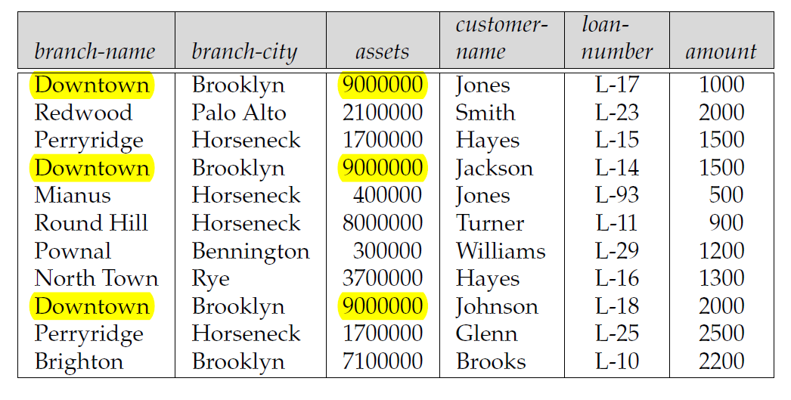
We say that the functional dependency
branch-name → assets holds on Lending-schema

Slide 14
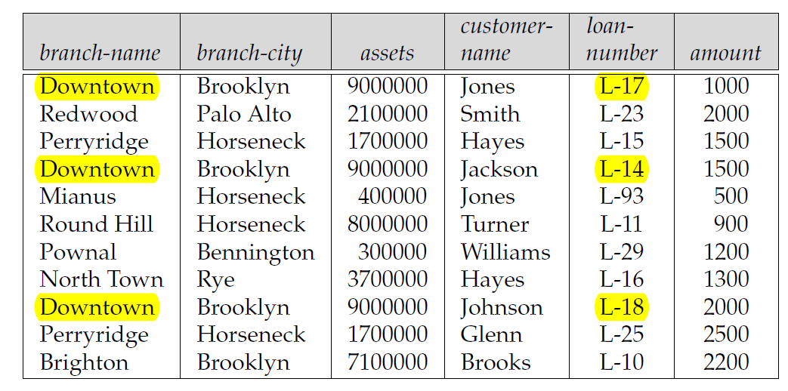
We do not expect the functional dependency branchname → loan-number to hold.

Slide 15
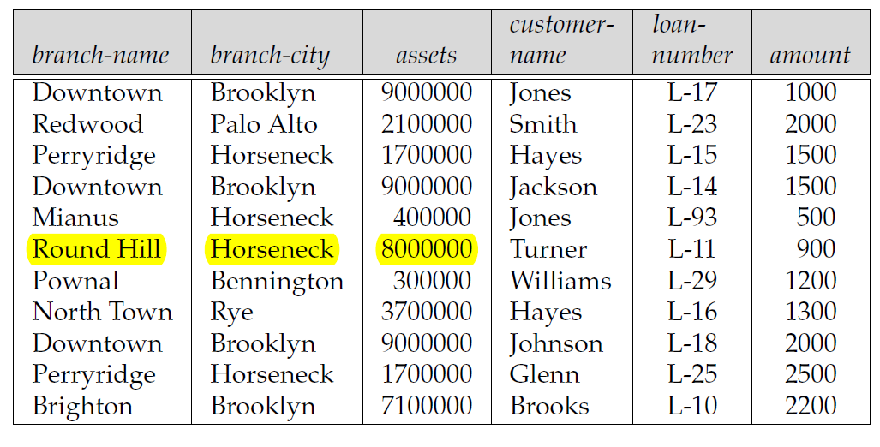
We cannot represent directly
the information concerning a branch (branch-name, branch-city, assets

Slide 16
Repetition of information Inability to represent certain information

Slide 17
Decomposition
Decompose the relation schema Lending-schema into:
Branch-schema = (branch-name, branch-city,assets)
Loan-info-schema = (customer-name, loan-number, branch-name, amount)
All attributes of an original schema (R) must appear in the decomposition (R₁, R₂):
R = R₁ ∪ R₂
Lossless-join decomposition. For all possible relations r on schema R
r = ∏_{R1} (r) ∏_{R2} (r)

Slide 18
Example of Non Lossless-Join Decomposition
Decomposition of R = (A, B) R₂ = (A) R₂ = (B)
A
B
A
B
α
α
β
1
2
1
α
β
1
2
∏_{A}(r)
∏_{B(r)}
r

Slide 19
Example of Non Lossless-Join Decomposition
Decomposition of R = (A, B) R₂ = (A) R₂ = (B)
A
B
A
B
α
α
β
1
2
1
α
β
1
2
∏_{A}(r)
∏_{B(r)}
r
∏_{A} (r) ∏_{B} (r)
A
B
α
α
β
β
1
2
1
2

Slide 20
Goal — Devise a Theory for the Following
Decide whether a particular relation R is in “good” form.
In the case that a relation R is not in “good” form, decompose it into a set of relations {R₁, R₂, ..., R_{n}} such that
each relation is in good form
the decomposition is a lossless-join decomposition
Our theory is based on:
functional dependencies
multivalued dependencies

Slide 21
Functional Dependencies
Constraints on the set of legal relations.
Require that the value for a certain set of attributes determines uniquely the value for another set of attributes.
A functional dependency is a generalization of the notion of a key.
Example:
branch-name → assets

Slide 22
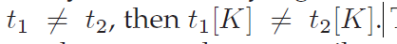
Functional Dependencies
A subset K of R is a superkey of R if, in any legal relation r(R),
for all pairs
t1 and t2 of tuples in r such
That is, no two tuples in any legal relation r(R) may have the same value on attribute set K.

Slide 23
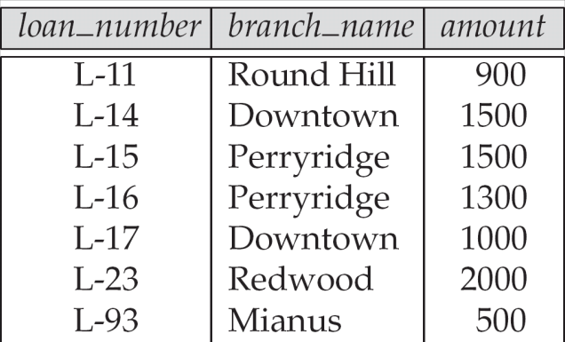
The loan relation

Slide 24
The loan relation

Slide 25
Using the functional-dependency notation, we say that K is a superkey of R
if K → R.
That is, K is a superkey
If, whenever t1[K] = t2[K],
it is also the case that t1[R] = t2[R]
(that is, t1 = t2).

Slide 26
Functional Dependencies (Cont.)
Let R be a relation schema
α ⊆ R and β ⊆ R
The functional dependency
α → β holds on R if and only if for any legal relations r(R), whenever any two tuples t₁ and t₂ of r agree on the attributes α, they also agree on the attributes β. That is,
t₁[α] = t₂ [α] ⇒ t₁[β ] = t₂ [β ]

Slide 27
Functional Dependencies (Cont.)
A | B | C | D
a1 | b1 | C1 | d1
a1 | B2 | C1 | d2
a2 | B2 | C2 | d2
a2 | B3 | C2 | d3
a3 | B3 | C2 | D4

Slide 28
Functional Dependencies (Cont.)
A | B | C | D
a1 | b1 | C1 | d1
a1 | B2 | C1 | d2
a2 | B2 | C2 | d2
a2 | B3 | C2 | d3
a3 | B3 | C2 | D4
A → C is satisfied
The functional dependency C → A is not satisfied,
consider the tuples t1 = (a2, b3, c2, d3)
t2 = (a3, b3, c2, d4).
r satisfies AB → D.
There is no pair of distinct tuples t1 and t2 such that t1[AB] = t2[AB].
Therefore, if t1[AB] = t2[AB], it must be that t1 = t2
and, thus, t1[D] = t2[D]. So, r satisfies AB → D.

Slide 29

Some functional dependencies are said to be trivial because they are satisfied by all relations.
For example, A → A is satisfied by all relations involving attribute A.
For all tuples t1, and t2 such that t1[A] = t2[A],
it is the case that t1[A] = t2[A].
Similarly, AB → A, is satisfied by all relations involving attribute A.
In general, a functional dependency of the form
α → β is trivial if β ⊆ α.

Slide 30
Functional Dependencies (Cont.)
K is a superkey for relation schema R if and only if K → R
K is a candidate key for R if and only if
K → R, and
for no α ⊂ K, α → R
Functional dependencies allow us to express constraints that cannot be expressed using superkeys. Consider the schema:
Loan-info-schema = (customer-name, loan-number, branch-name, amount).
We expect this set of functional dependencies to hold:
loan-number → amount loan-number → branch-name ?
but would not expect the following to hold:
loan-number → customer-name

Slide 32
We say that the functional dependency
branch-name → assets holds on Lending-schema

Slide 33
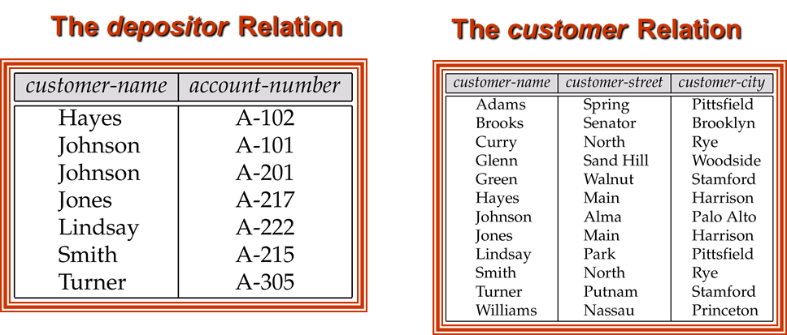
On Customer-schema:
customer-name→ customer-city
customer-name→ customer-street
On Depositor-schema:
No functional dependencies

Slide 34
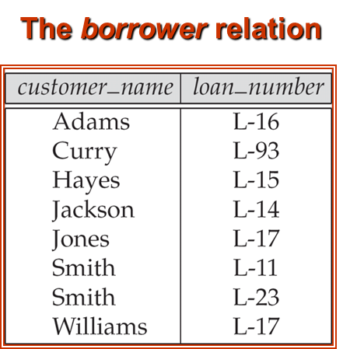
The loan relation
• On Loan-schema:
loan-number → amount
loan-number → branch-name
On Borrower-schema:
No functional dependencies

Slide 35
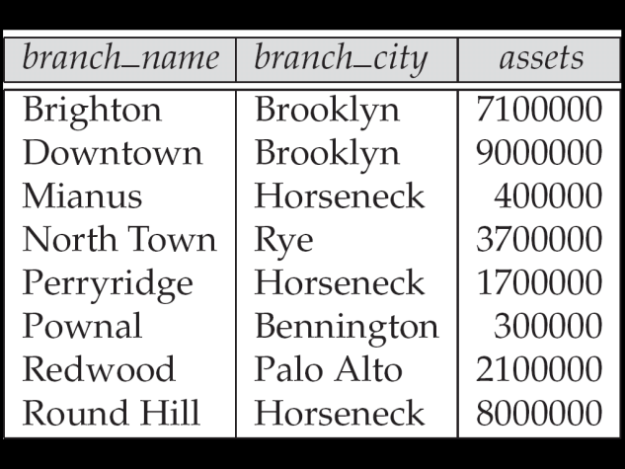
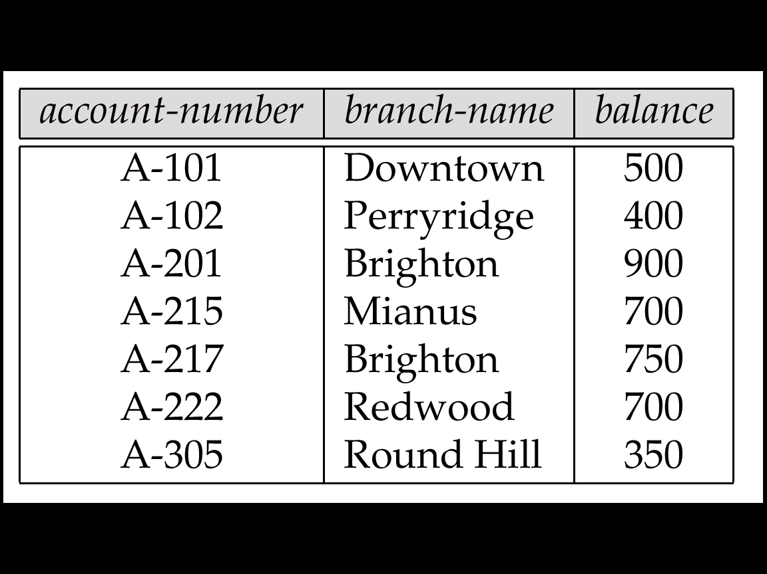
The branch relation
The account relation
On Branch-schema:
branch-name →branch-city
branch-name →assets
On Account-schema:
account-number → branch-name
account-number → balance

Slide 36
Use of Functional Dependencies
We use functional dependencies to:
test relations to see if they are legal under a given set of functional dependencies.
If a relation r is legal under a set F of functional dependencies, we say that r satisfies F.
specify constraints on the set of legal relations
We say that F holds on R if all legal relations on R satisfy the set of functional dependencies F.

Slide 37
Use of Functional Dependencies
Note: A specific instance of a relation schema may satisfy a functional dependency even if the functional dependency does not hold on all legal instances.
For example, a specific instance of Loan-schema may, by chance, satisfy loan-number → customer-name.

Slide 38
Functional Dependencies (Cont.)
A functional dependency is trivial if it is satisfied by all instances of a relation
E.g.
customer-name, loan-number → customer-name
customer-name → customer-name
In general, α → β is trivial if β ⊆ α

Slide 39
Closure of a Set of Functional Dependencies
Given a set F set of functional dependencies, there are certain other functional dependencies that are logically implied by F.
E.g. If A → B and B → C, then we can infer that A → C
The set of all functional dependencies logically implied by F is the closure of F.
We denote the closure of F by F⁺.

Slide 40
Functional Dependencies (Cont.)
A →B
A →C
CG→ H
CG→ I
B → H
The functional dependency
A→ H
Suppose that, t1 and t2 are tuples such that
t1[A] = t2[A]
Since we are given that A→B,
t1[B] = t2[B]
Then, since we are given that B → H
t1[H] = t2[H]

Slide 41
Closure of a Set of Functional Dependencies
We can find all of F⁺ by applying Armstrong’s Axioms:
if β ⊆ α, then α → β (reflexivity)
if α → β, then γ α → γ β (augmentation)
if α → β, and β → γ, then α → γ (transitivity)
These rules are
sound (generate only functional dependencies that actually hold) and
complete (generate all functional dependencies that hold).

Slide 42
Closure of Functional Dependencies (Cont.)
We can further simplify manual computation of F⁺ by using the following additional rules.
If α → β holds and α → γ holds, then α → β γ holds (union)
If α → β γ holds, then α → β holds and α → γ holds (decomposition)
If α → β holds and γ β → δ holds, then α γ → δ holds (pseudotransitivity)
The above rules can be inferred from Armstrong’s axioms.

Slide 43
Example
R = (A, B, C, G, H, I) F = { A → B A → C CG → H CG → I B → H}

Slide 44
Example
some members of F⁺
CG → HI
from CG → H and CG → I : “union rule” can be inferred from
definition of functional dependencies, or
Augmentation of CG → I
to infer CG → CGI {that is, CGCG →CGI}
Augmentation of CG → H
to infer CGI → HI {that is, CGI →CGI}
And transitivity
CG → HI
R = (A, B, C, G, H, I) F = { A → B A → C CG → H CG → I B → H}

Slide 45
Procedure for Computing F⁺
To compute the closure of a set of functional dependencies F:
F⁺ = F repeat for each functional dependency f in F⁺ apply reflexivity and augmentation rules on f add the resulting functional dependencies to F⁺ for each pair of functional dependencies f₁and f₂ in F⁺ if f₁ and f₂ can be combined using transitivity then add the resulting functional dependency to F⁺ until F⁺ does not change any further
NOTE: We will see an alternative procedure for this task later

Slide 46
Closure of Attribute Sets
Given a set of attributes α, define the closure of α under F (denoted by α⁺) as the set of attributes that are functionally determined by α under F: α → β is in F⁺ ⬄ β ⊆ α⁺
Algorithm to compute α⁺, the closure of α under F result := α; while (changes to result) do for each f1→ f2 in F do begin if f1 ⊆ result then result := result ∪ f2 end

Slide 47
Example of Attribute Set Closure
R = (A, B, C, G, H, I)
F = {A → B A → C CG → H CG → I B → H}

Slide 48
Example of Attribute Set Closure
(AG)⁺
1. result = AG
2. result = ABCG (A → C and A → B)
3. result = ABCGH (CG → H and CG ⊆ AGBC)
4. result = ABCGHI (CG → I and CG ⊆ AGBCH)
R = (A, B, C, G, H, I)
F = {A → B A → C CG → H CG → I B → H}

Slide 49
Closure of Functional Dependencies (Cont.)
Given the following FDs
A→ BC , CD→ E, E→ C
D→ AEH, ABH → BD, DH→ BCA
Find out, whether BCD → H or not from the following Functional Dependencies?
Solution :Compute the closure of
BCD = BCD⁺
BCD⁺ = BCD
= ABCDEH {as D → AEH}
Hence BCD → H is true as the closure contains H.

Slide 50
Example of Attribute Set Closure
Suppose we are given relation R with attributes A,B,C,D and
FDs A→BC B→CD
(B⁺) = {BCD}
(C⁺) = {C}
(D⁺) = {D}
(AB⁺) = {ABCD}
(AC⁺) = {ABCD}
(AD⁺) = {ABCD}
(BC⁺) = {BCD}
(BD⁺) = {BCD}
(CD⁺) = {CD

Slide 51
Example of Attribute Set Closure
relation schema R = {A, B, C, D, E}.
A → BC
CD → E
B → D
E → A

Slide 52
Example of Attribute Set Closure
(A)⁺ = {ABCDE}
(AB)⁺ = {ABCDE}
(AC)⁺ = {ABCDE}
(BC)⁺ = {ABCDE}
(BD)⁺ = {BD}
(BE)⁺ = {ABCDE}
(CD)⁺ = {ABCDE}
(CE)⁺ = {ABCDE}
(DE)⁺ = {ABCDE}
(ABC)⁺ = {ABCDE}
relation schema R = {A, B, C, D, E}.
A → BC
CD → E
B → D
E → A

Slide 53
Uses of Attribute Closure
There are several uses of the attribute closure algorithm:
Testing for superkey:
To test if α is a superkey, we compute α^{+,} and check if α⁺ contains all attributes of R.

Slide 54
Example of Attribute Set Closure
(AG)⁺
1. result = AG
2. result = ABCG (A → C and A → B)
3. result = ABCGH (CG → H and CG ⊆ AGBC)
4. result = ABCGHI (CG → I and CG ⊆ AGBCH)
Is AG a candidate key?
Is AG a super key?
Does AG → R? == Is (AG)⁺ ⊇ R
Is any subset of AG a superkey?
Does A → R? == Is (A)⁺ ⊇ R
Does G → R? == Is (G)⁺ ⊇ R

Slide 55
Closure of Functional Dependencies (Cont.)
relational scheme R with attributes A,B,C,D,F and the FDs
A → BC, B → E, CD → EF
Prove that functional dependency AD → F holds in R.
Compute the closure of AD
(AD)⁺ = ADBCEF
Hence AD → E is true as the closure contains E.

Slide 56
Uses of Attribute Closure
Testing functional dependencies
To check if a functional dependency α → β holds (or, in other words, is in F⁺), just check if β ⊆ α⁺.
That is, we compute α⁺ by using attribute closure, and then check if it contains β.
Is a simple and cheap test, and very useful

Slide 57
Uses of Attribute Closure
Computing closure of F
For each γ ⊆ R,
we find the closure γ⁺,
and for each S ⊆ γ⁺,
we output a functional dependency γ → S.

Slide 58
Canonical Cover
Sets of functional dependencies may have redundant dependencies that can be inferred from the others
Eg: A → C is redundant in: {A → B, B → C, A → C}
Parts of a functional dependency may be redundant
E.g. on RHS: {A → B, B → C, A → CD} can be simplified to {A → B, B → C, ???? }
E.g. on LHS: {A → B, B → C, AC → D} can be simplified to {A → B, B → C, ???? }
Intuitively, a canonical cover of F is a “minimal” set of functional dependencies equivalent to F, having no redundant dependencies or redundant parts of dependencies

Slide 59
Canonical Cover
Sets of functional dependencies may have redundant dependencies that can be inferred from the others
Eg: A → C is redundant in: {A → B, B → C, A → C}
Parts of a functional dependency may be redundant
E.g. on RHS: {A → B, B → C, A → CD} can be simplified to {A → B, B → C, A → D}
E.g. on LHS: {A → B, B → C, AC → D} can be simplified to {A → B, B → C, A → D}
Intuitively, a canonical cover of F is a “minimal” set of functional dependencies equivalent to F, having no redundant dependencies or redundant parts of dependencies

Slide 60
Extraneous Attributes
An attribute of a functional dependency is said to be extraneous
If we can remove it
without changing the closure of the set of functional dependencies.

Slide 61
Extraneous Attributes
Consider a set F of functional dependencies and the functional dependency α → β in F.
Attribute A is extraneous in α if A ∈ α and F logically implies (F – {α → β}) ∪ {(α – A) → β}.
Example: Given F = {A → C, AB → C }
B is extraneous in AB → C
Because {A → C, AB → C} logically implies {A → C}
(I.e. the result of dropping B from AB → C).

Slide 62
Extraneous Attributes
Consider a set F of functional dependencies and the functional dependency α → β in F.
Attribute A is extraneous in α if A ∈ α and F logically implies (F – {α → β}) ∪ {(α – A) → β}.
Example: Given F = {A → C, AB → C }
B is extraneous in AB → C
Because {A → C, AB → C} logically implies {A → C}
(I.e. the result of dropping B from AB → C).
A → C
AB → CB
AB → C , AB → B

Slide 63
Extraneous Attributes
Consider a set F of functional dependencies and the functional dependency α → β in F.
Attribute A is extraneous in β if A ∈ β and the set of functional dependencies (F – {α → β}) ∪ {α →(β – A)} logically implies F.
Example: Given F = {A → C, AB → CD}
C is extraneous in AB → CD
Since AB → C can be inferred even after deleting C

Slide 64
Extraneous Attributes
Consider a set F of functional dependencies and the functional dependency α → β in F.
Attribute A is extraneous in β if A ∈ β and the set of functional dependencies (F – {α → β}) ∪ {α →(β – A)} logically implies F.
Example: Given F = {A → C, AB → CD}
C is extraneous in AB → CD
Since AB → C can be inferred even after deleting C
AB → CD
AB → D, AB → C
A → C
AB → BC
AB → C , AB → B

Slide 65
Extraneous Attributes
Note: implication in the opposite direction is trivial in each of the cases above, since a “stronger” functional dependency always implies a weaker one

Slide 66
Testing if an Attribute is Extraneous
Consider a set F of functional dependencies and the functional dependency α → β in F.
To test if attribute A ∈ α is extraneous in α
compute ({α} – A)⁺ using the dependencies in F
check that ({α} – A)⁺ contains A; if it does, A is extraneous
To test if attribute A ∈ β is extraneous in β
compute α⁺ using only the dependencies in F’ = (F – {α → β}) ∪ {α →(β – A)},
check that α⁺ contains A; if it does, A is extraneous

Slide 67
Testing if an Attribute is Extraneous
Let F be the given set of functional dependencies that hold on R.
Consider an attribute A in a dependency α → β.
If A ∈ α, to check if A is extraneous, let γ = α − {A}, and check if γ → β can be inferred from F.
To do so, compute γ⁺ (the closure of γ) under F’
If γ⁺ includes all attributes in β, then A is extraneous in α.

Slide 68
Testing if an Attribute is Extraneous
Let F be the given set of functional dependencies that hold on R.
Consider an attribute A in a dependency α → β.
If A ∈ β , to check if A is extraneous consider the set, Check if α → A can be inferred from F’.
To do so, compute α+ (the closure of α) under F’,
F’ = (F − {α → β}) ∪ {α → (β − A)}
If α⁺ includes A, then A is extraneous in β .

Slide 69
Example
F = {AB → CD,
A → E,
E → C}
Case 1. if C is extraneous in AB → CD,
Find {AB}⁺ under F‘= {AB → D, A → E, and E → C}
{AB}⁺ = {ABCDE}
which includes CD, So C is extraneous.

Slide 70
Canonical Cover
A canonical cover for F is a set of dependencies F_{c} such that
F logically implies all dependencies in F_{c,} and
F_{c} logically implies all dependencies in F, and
No functional dependency in F_{c} contains an extraneous attribute, and
Each left side of functional dependency in F_{c} is unique.

Slide 71
Canonical Cover
To compute a canonical cover for F: repeat Use the union rule to replace any dependencies in F α₁ → β₁ and α₁ → β₂ with α₁ → β₁ β₂ Find a functional dependency α → β with an extraneous attribute either in α or in β If an extraneous attribute is found, delete it from α → β until F does not change
Note: Union rule may become applicable after some extraneous attributes have been deleted, so it has to be re-applied

Slide 72
Testing if an Attribute is Extraneous
Let F be the given set of functional dependencies that hold on R.
Consider an attribute A in a dependency α → β.
If A ∈ α, to check if A is extraneous, let γ = α − {A}, and check if γ → β can be inferred from F.
To do so, compute γ⁺ (the closure of γ) under F’
If γ⁺ includes all attributes in β, then A is extraneous in α.

Slide 73
Testing if an Attribute is Extraneous
Let F be the given set of functional dependencies that hold on R.
Consider an attribute A in a dependency α → β.
If A ∈ β , to check if A is extraneous consider the set, Check if α → A can be inferred from F’.
To do so, compute α+ (the closure of α) under F’,
F’ = (F − {α → β}) ∪ {α → (β − A)}
If α⁺ includes A, then A is extraneous in β .

Slide 74
Example of Computing a Canonical Cover
R = (A, B, C) F = {A → BC B → C A → B AB → C}
Combine A → BC and A → B into A → BC
Set is now {A → BC, B → C, AB → C}

Slide 75
Example of Computing a Canonical Cover
A is extraneous in AB → C
Check if the result of deleting A from AB → C is implied by the other dependencies
Yes: in fact, B → C is already present!
F logically implies (F − {AB → C}) ∪ {B → C}.
Set is now {A → BC, B → C}
C is extraneous in A → BC
Check if A → C is logically implied by A → B and the other dependencies
Yes: using transitivity on A → B and B → C.
Can use attribute closure of A in more complex cases
The canonical cover is: A → B B → C

Slide 76
Canonical Cover - 1
Given a relation R with a set of FDs F
4 steps to find a canonical cover for F:
Step 1: Decompose all FDs in standard form
Replace each FD X → A1A2…Ak in F with X→A1, X→A2, …, X→Ak

Slide 77
Canonical Cover - 2
Step 2: Eliminate unnecessary attributes from LHS
For every FD X → A in F, check if the closure of a subset of X determines A. If so, remove redundant attribute(s) from X

Slide 78
Canonical Cover - 3
Step 3: Remove redundant FD(s)
For every FD X → A in G
Remove X → A from G, and call the result G’
Compute X⁺ under G’
If A ∈ X⁺, then X → A is redundant. Hence, we remove the FD X → A from G (That is, we rename G’ to G)

Slide 79
Canonical Cover - 4
Step 4: Make LHS of FDs unique
Replace X→A1, X→A2, …, X→Ak with X → A1A2…Ak

Slide 80
Example 1 Computing a Canonical Cover
F= functional dependencies :
AB → CD
BC → D
Step 1 : Union Simplification :
AB → C ..(1)
AB → D ..(2)
BC → D ..(3)

Slide 81
Example 1 Computing a Canonical Cover
Step 2 : Removal of Redundant set of FDs -
(i) Find the closure of LHS of (1),
i.e. Compute (AB)+ from (2) and (3) by hiding (1).
(AB)+ = {ABD}, AB → C is non redundant
(II) Similarly for (2),
Compute (AB)+ from (1) and (3) by hiding (2).
(AB)+ = {ABCD}, AB → D is redundant
Remaining FDs = {AB→C, BC→D}

Slide 82
Example1 Computing a Canonical Cover
For (3), Compute (BC)+ from (1) and (2) by hiding (3).
(BC)+ = {BC}, BC → D is also non redundant

Slide 83
Example 1 Computing a Canonical Cover
LHS Simplification or Removal of Extraneous Attributes -
FDs remained after step 2
AB→C .. (3)
BC→D .. (4)

Slide 84
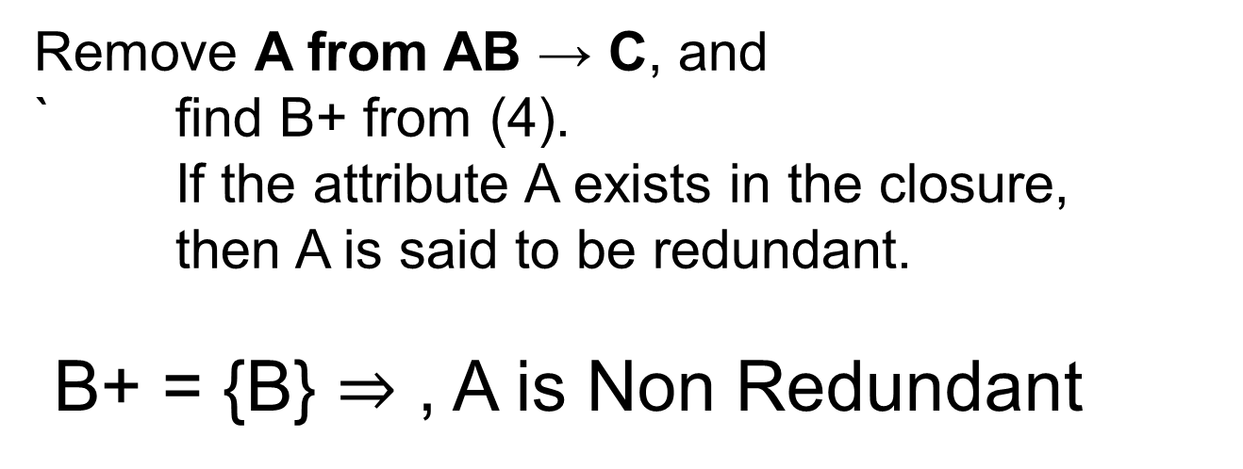
Example 1 Computing a Canonical Cover
Remove B from AB → C and
find A^{+ f}rom (4).
A⁺ = {A} ⇒ , B is Non Redundant.

Slide 85
Example 1 Computing a Canonical Cover
Remove B from BC → D, and
find C+ from (3).
C⁺ = {C} ⇒ B is Non Redundant
Remove C from BC → D and
find B+ from (3).
B⁺ = {B} ⇒ C is Non Redundant

Slide 86
Example 2 Computing a Canonical Cover
F= functional dependencies :
ABCD → E .. (1)
E → D .. (2)
AC → D .. (3)
A → B .. (4)
Removal of redundant set of FDs -
(i) For (1),
Compute (ABCD)+ from (2) (3) and (4) by hiding (1).
(ABCD)+ = {ABCD}
⇒ ABCD → E is non redundant.

Slide 87
Example 2 of Computing a Canonical Cover
For (2),
Compute (E)+ from (1) (3) and (4) by hiding (2).
(E)+ = {E}
⇒ E → D is non redundant.
(iii) For (3)
Compute (AC)+ from (1) (2) and (4) by hiding (3). (AC)+ = {ACB}
⇒ AC → D is non redundant.
(iV) For (4),
Compute (A)+ from (1) (2) and (3) by hiding (4). (A)+ = {A}
⇒ A → B is non redundant.

Slide 88
Example 2 of Computing a Canonical Cover
Step 3 : LHS Simplification or Removal of Extraneous Attributes -
Remove A from ABCD → E
(BCD)+ = {BCD} ⇒ A is Non Redundant
(II) Remove B from ABCD → E
(ACD)+ = {ACDB} ⇒ B is Redundant.
ACD → E
(III) Remove C from ACD → E
(AD)+ = {ADB} ⇒ C is Non Redundant.
(iV) Remove D from ACD → E,
AC)+ = {ACDB} ⇒ D is Redundant.

Slide 89
Example of Computing a Canonical Cover
Remove A from AC → D
(C)+ = {C} ⇒ A is non redundant.
Remove C from AC → D
A)+ = {AB} ⇒ C is non redundant.

Slide 90
Example 2 Computing a Canonical Cover
FDs remained after step 3 are :
AC → E .. (5)
E → D .. (6)
AC → D .. (7)
A → B .. (8)

Slide 91
Example 2 Computing a Canonical Cover
Applying step 2 again to find redundant FDs -
(i) For (5), Compute (AC)+ ).
(AC)+ = {ACDB} , ⇒ AC → E is non redundant.
(ii) For (6), Compute (E)+
(E)+ = {E}, ⇒ E → D is non redundant.
(iii) For (7), Compute (AC)+ .
(AC)+ = {ACEDB}, ⇒ AC → D is redundant.
(iv) For (8), Compute (A)+
(A)+ = {AB}, ⇒ A → B is non redundant.

Slide 92
Example 2 Computing a Canonical Cover
Finally Canonical Cover will be
AC → E
E → D
A → B

Slide 93
Example 2 Computing a Canonical Cover
A canonical cover is "allowed" to have more than one attribute on the right hand side.
A minimal cover cannot.
As an example,
the canonical cover may be "A -> BC"
the minimal cover would be "A -> B, A -> C

Slide 94
Goals of Normalization
Decide whether a particular relation R is in “good” form.
In the case that a relation R is not in “good” form, decompose it into a set of relations {R₁, R₂, ..., R_{n}} such that
each relation is in good form
the decomposition is a lossless-join decomposition
Our theory is based on:
functional dependencies
multivalued dependencies

Slide 95
Example of Lossy-Join Decomposition
Lossy-join decompositions result in information loss.
Example: Decomposition of R = (A, B) R₂ = (A) R₂ = (B)
A
B
A
B
α
α
β
1
2
1
α
β
1
2
∏_{A}(r)
∏_{B(r)}
r
∏_{A} (r) ∏_{B} (r)
A
B
α
α
β
β
1
2
1
2

Slide 96
Lending-schema = (branch-name, branch-city, assets, customer-name, loan-number, amount)

Slide 97
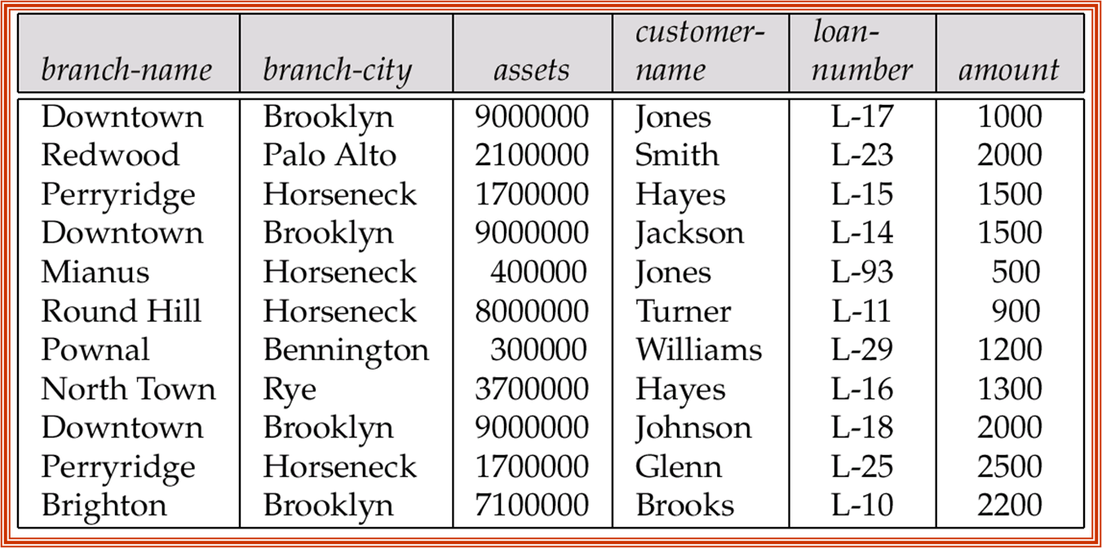
Branch-customer-schema =
(branch-name, branch-city, assets, customer-name)
Customer-loan-schema =
(customer-name, loan-number, amount)

Slide 98
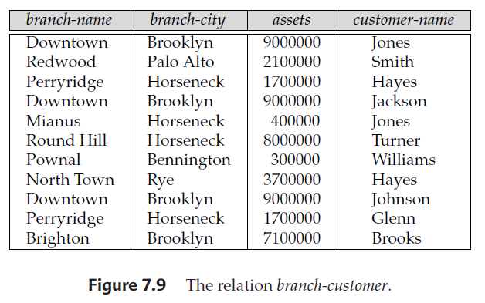

Slide 99
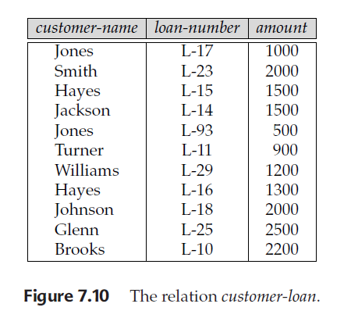

Slide 100
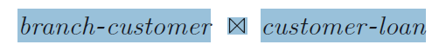
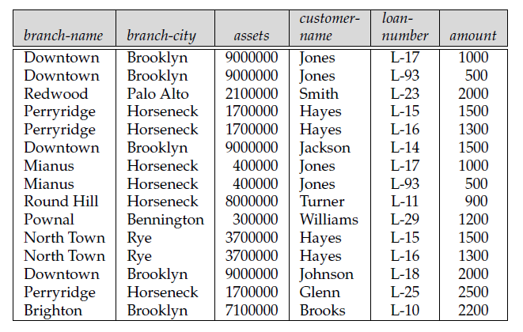

Slide 101
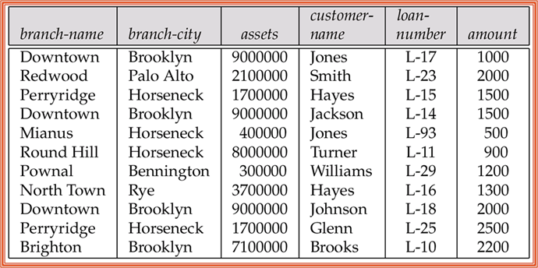

Slide 104
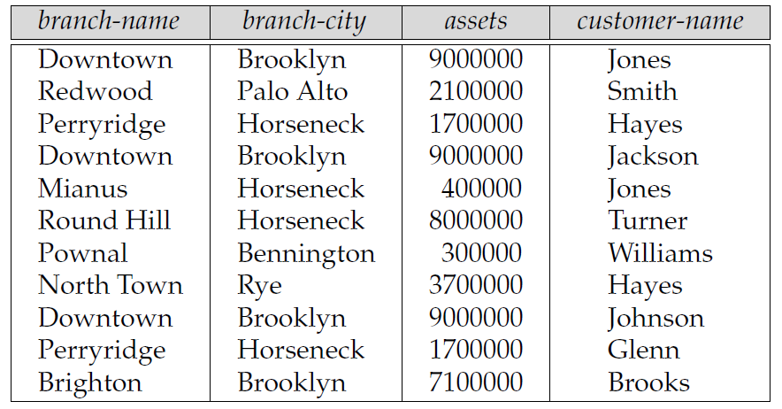
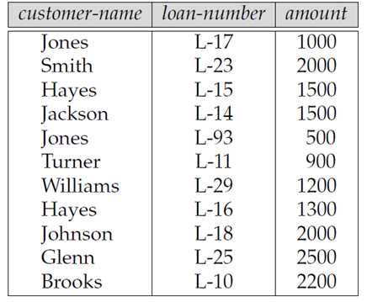
Problem: If a customer happens to have several loans from different branches, we cannot tell which loan belongs to which branch.
Thus, when we join branch-customer and customer-loan, we obtain not only the tuples we had originally in lending, but also several additional tuples.
(Downtown, Brooklyn, 9000000, Jones, L-93, 500)
(Perryridge, Horseneck, 1700000, Hayes, L-16, 1300)
(Mianus, Horseneck, 400000, Jones, L-17, 1000)
(North Town, Rye, 3700000, Hayes, L-15, 1500)

Slide 105
Lending-schema = (branch-name, branch-city, assets, customer-name, loan-number, amount)

Slide 106
Problem: If a customer happens to have several loans from different branches, we cannot tell which loan belongs to which branch.
Thus, when we join branch-customer and customer-loan, we obtain not only the tuples we had originally in lending, but also several additional tuples.
(Downtown, Brooklyn, 9000000, Jones, L-93, 500)
(Perryridge, Horseneck, 1700000, Hayes, L-16, 1300)
(Mianus, Horseneck, 400000, Jones, L-17, 1000)
(North Town, Rye, 3700000, Hayes, L-15, 1500)

Slide 107
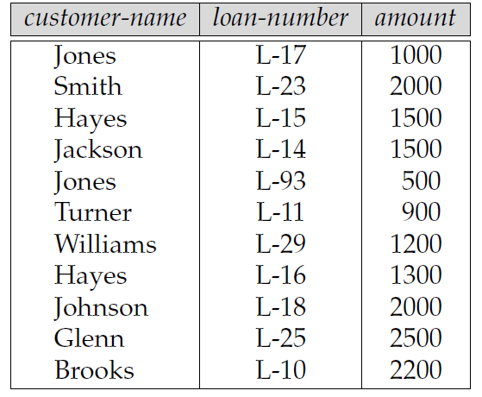
branch-customer = Πbranch-name, branch-city, assets, customer-name (lending)
customer-loan =
Πcustomer-name, loan-number, amount (lending)

Slide 109
Why is the decomposition lossy
There is one attribute in common between
Branchc-ustomer-schema and Customer-loan-schema:
Branch-customer-schema ∩ Customer-loan-schema = {customer-name}
The only way that we can represent a relationship between:
Example
loan-number and branch-name is through customer-name.
This representation is not adequate because
A customer may have several loans, yet
These loans are not necessarily obtained from the same branch

Slide 110
Alternative Design?
Branch-schema = (branch-name, branch-city, assets)
Loan-info-schema = (branch-name, customer-name, loan-number, amount)
Branch-loan-schema ∩ Customer-loan-schema = {branch-name}
For a given branch-name,
there is exactly one assets value and exactly one branch-city
branch-name → assets, branch-city

Slide 111
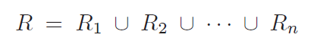
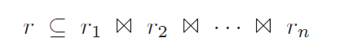
In general:
Let r be a relation on schema R, and
let ri = ΠRi(r) for i = 1, 2, . . . , n.

Slide 112
Lossless-join decomposition
A relation is legal if it satisfies all rules, or constraints,
that we impose on our database.
A lossless-join decomposition if,
for all relations r on schema R that are
legal under C, set of constraints

Slide 113
Desirable Properties of Decomposition
Lending-schema =
(branch-name, branch-city, assets, customer-name,
loan-number, amount)
branch-name → branch-city assets
loan-number → amount branch-name
?????
Branch-schema = (branch-name, branch-city, assets)
Loan-schema = (loan-number, branch-name, amount)
Borrower-schema = (customer-name, loan-number)

Slide 114
Lossless-join decomposition
Let
R be a relation schema,
F be a set of functional dependencies on R.
Let
R1 and R2 form a decomposition of R.
This decomposition is a lossless-join decomposition of R
if at least one of the following functional dependencies is in F⁺:
R1 ∩ R2 → R1
R1 ∩ R2 → R2

Slide 115
Decomposition
Decompose the relation schema Lending-schema into:
Branch-schema = (branch-name, branch-city,assets)
Loan-info-schema = (customer-name, loan-number, branch-name, amount)
All attributes of an original schema (R) must appear in the decomposition (R₁, R₂):
R = R₁ ∪ R₂
Lossless-join decomposition. For all possible relations r on schema R
r = ∏_{R1} (r) ∏_{R2} (r)
A decomposition of R into R₁ and R₂ is lossless join if and only if at least one of the following dependencies is in F⁺:
R₁ ∩ R₂ → R₁
R₁ ∩ R₂ → R₂

Slide 116
Desirable Properties of Decomposition
Lending-schema =
(branch-name, branch-city, assets, customer-name,
loan-number, amount)
Branch-schema = (branch-name, branch-city, assets)
Loan-info-schema = (branch-name, customer-name, loan-number, amount)
branch-name → branch-name branch-city assets
Branch-schema ∩ Loan-info-schema = {branch-name}

Slide 117
Desirable Properties of Decomposition
Branch-schema = (branch-name, branch-city, assets)
Loan-info-schema = (branch-name, customer-name, loan-number, amount)
Loan-schema = (loan-number, branch-name, amount)
Borrower-schema = (customer-name, loan-number)
loan-number → loan-number amount branch-name.
Loan-schema ∩ Borrower-schema = {Loan-number}

Slide 118
Desirable Properties of Decomposition
Lending-schema =
(branch-name, branch-city, assets, customer-name,
loan-number, amount)
Branch-schema = (branch-name, branch-city, assets)
Loan-info-schema = (branch-name, customer-name, loan-number, amount)
branch-name → branch-name branch-city assets
Branch-schema ∩ Loan-info-schema = {branch-name}

Slide 119
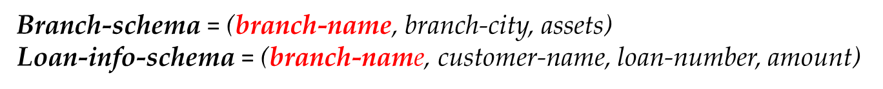
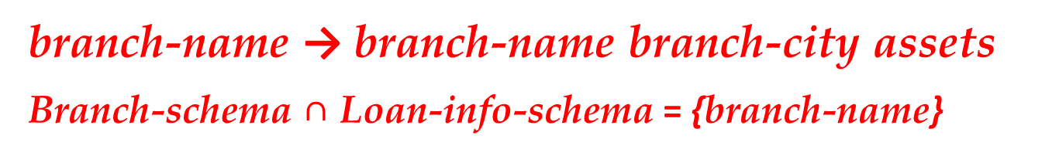
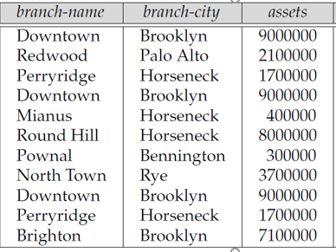
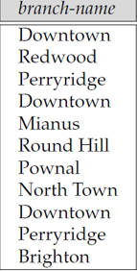
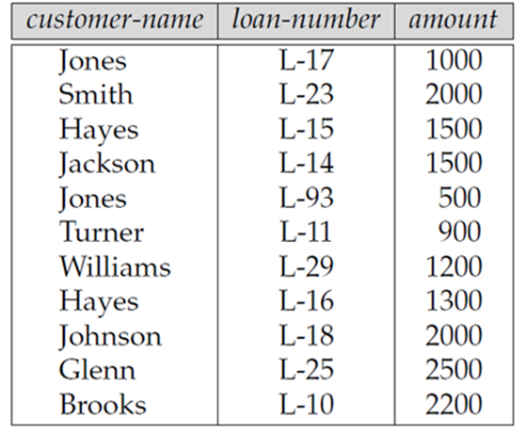

Slide 120
Dependency Preservation
F = {A → B, B → C}
Let decomposed into {AC} and {AB}.
The restriction of F to {AC} is then A → C,
Since A → C is in F⁺
Even though it is not in F.

Slide 121
Dependency Preservation
The input is a set
D = {R₁, R₂, . . .,R_{n}}
decomposed relation schemas
The set of restrictions
F₁, F₂, . . . , F_{n}
is the set of dependencies that can be checked efficiently.
Let
F´= F₁ ∪ F₂ ∪ · · · ∪ F_{n}.
F is a set of functional dependencies on schema R
But, in general, F´⁺ = F⁺
(When Decomposition is Dependency Preserving)
.

Slide 122
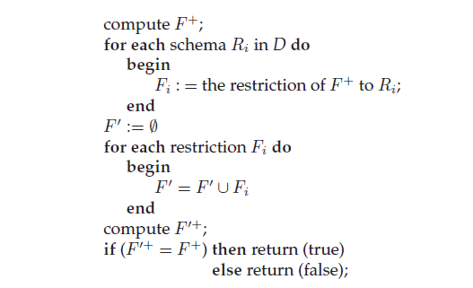
Dependency Preservation
The input is a set D = {R₁, R₂, . . .,R_{n}}
Decomposed relation schemas

Slide 123
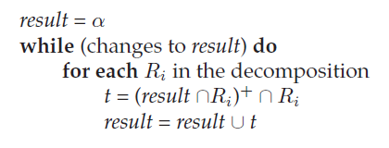
Dependency Preservation
Apply the following procedure to each α → β in F.
The attribute closure is with respect to the functional dependencies in F.
If result contains all attributes in β
Then the functional dependency α → β is preserved
The decomposition is dependency preserving
if and only if all the dependencies in F are preserved.

Slide 124
Dependency Preservation
Example:
F= A → B, B → C
Decomposed into R1={AB}, R2={AC}
For R2= {AC} to check dependency preservation A → C ??
α = {A}
result = {A}
result ∩ R2= {A}
{result ∩ R2}+ = {A}+
= {ACB}
{result ∩ R2}+ ∩ R2
= {ACB} ∩ {AC}
= {AC}
t= {AC}
result = result ∪ t
= {A} ∪ {AC}
= {AC}
= β

Slide 125
Apply the procedure to each α → β in F.
Example:
F= A → B, B → C
Decomposed into R1={AB}, R2={AC}
For R2= {AC} to check dependency preservation A → C ??
α = {A}
result = {A}
result ∩ R2= {A}
{result ∩ R2}+ = {A}+
= {ABC}
{result ∩ R2}+ ∩ R2
= {ACB} ∩ {AC}
= {AC}
t= {AC}
result = result ∪ t
= {A} ∪ {AC}
= {AC}
= β

Slide 126
Example: Dependency Preservation in Decomposition
Let a relation R(A,B,C,D) and set of FDs
F = { A → B , A → C , C → D} are given.
A relation R is decomposed into -
R₁ = (A, B, C) with FDs F₁ = {A →B, A →C}
R₂ = (C, D) with FDs F₂ = {C →D}.
F' = F₁ ∪ F₂ = {A →B, A →C, C →D}
so, F' = F.
And, F'⁺ = F⁺.

Slide 127
Functional Dependency
Functional dependency α → β means,
If we know the value of α,
we can determine β
corresponding value of β
value of β in the that record
Never Compute the value of β as function
For α → β to be true
If t1.α = t2.α Then t1.β =t2.β
For R={A,B,C,D}
If t1.A=t2.A Then t1.B=t2.B for A → B
If t1.B=t2.B Then t1.C=t2.C for B → C
If t1.A=t2.A Then t1.C=t2.C for A → C
We first check the first part, if it TRUE
then we will go for 2nd part

Slide 128
Functional Dependency
A | B | C
1 | 1 | 1
2 | 1 | 2
3 | 2 | 1
4 | 2 | 2
If t1.A=t2.A Then t1.B=t2.B
If t1.A=t2.A Then t1.C=t2.C
There is no duplicate value for A,
That’s means, for each value of A,
we can determine corresponding value of B and C
That means:
A → B
and
A → C
That means: A → BC

Slide 129
Functional Dependency
A | B | C
1 | 1 | 1
2 | 1 | 2
3 | 2 | 1
4 | 2 | 2
If t1.BC=t2.BC Then t1.A=t2.A
There is no duplicate value for BC,
That’s means, for each value of BC,
we can determine corresponding value of A
That means:
BC→ A

Slide 130
Functional Dependency
A | B | C
1 | 1 | 1
2 | 1 | 2
3 | 2 | 1
4 | 2 | 2
If t1.B=t2.B Then t1.C=t2.C
Lets check first two records:
1=1 (for t1.B=t2.B ) but 1 ≠ 2 ( t1.C ≠ t2.C)
That means,
If we ask, what will corresponding value of C for B=1,
There are TWO corresponding values for C, 1 and 2, which will be returned ?
Thank means
B→ C becomes False
Same way: B→ A, C→ B, becomes False

Slide 131
Functional Dependency Preservation
A | B
1 | 1
2 | 1
3 | 2
4 | 2
B | C
1 | 1
1 | 2
2 | 1
2 | 2
R1 = [AB}
A → B True
B → A False
R1 = [BC}
B → C False
C → B False

Slide 132
Functional Dependency Preservation
A | B | C
1 | 1 | 1
2 | 1 | 2
3 | 2 | 1
4 | 2 | 2
A | B
1 | 1
2 | 1
3 | 2
4 | 2
B | C
1 | 1
1 | 2
2 | 1
2 | 2
R={ABC}
F= {BC→ A, A → BC}
R1 = [AB}
F1= {A → B}
R1 = [BC}
F2= { }
F´= F1 υ F2
= {A → B}
Therefore, F´ ≅ F Becomes False
NOT dependency preserving

Slide 133
Functional Dependency Preservation
R = {ABCDE}
F = {A → B, B → C, C → D, D → A}
R1 = {ABC} R2 = {CDE}

Slide 134
Functional Dependency Preservation
R = {ABCDE}
F = {A → B, B → C, C → D, D → A}
R1 = {ABC}
A⁺ = ABCD <delete A as Trivial, D is not in R1>
=BC Therefore, A → BC …...(1)
B⁺ = BCDA <delete B as Trivial, D is not in R1>
=CA Therefore, B → CA ……(2)
C⁺ = CDAB <delete C as Trivial, D is not in R1>
=AB Therefore, C → AB ……(3)
AB⁺ = ABCD <delete AB as Trivial, D is not in R1>
=C Therefore, AB → C ……(4)
redundant since from (1), A → B, A → C
Same way, BC⁺ and CA⁺ are redundant BC → A, CA → B
ABC⁺ is Trivial
F1 = {A → BC, B → CA, C → AB }

Slide 135
R = {ABCDE}
F = {A → B, B → C, C → D, D → A}
R2 = {CDE}
C⁺ = CDAB <delete C as Trivial, AB is not in R2>
=D Therefore, C → D …...(5)
D⁺ = DBAC <delete D as Trivial, AB is not in R2>
=C Therefore, D → C ……(6)
E⁺ = E <delete E as Trivial>
={ }
CD⁺ = CD <delete CD as Trivial, AB is not in R2>
={ }
DE⁺ = DEABC <delete DE as Trivial, AB is not in R2>
Therefore, DE → C ……(4)
redundant since from (6), D → C
Same way, CE⁺ is redundant CE → D
CDE⁺ is Trivial
F2 = {C → D , D → C }

Slide 136
Functional Dependency Preservation
R = {ABCDE} F = {A → B, B → C, C → D, D → A}
R1 = {ABC} F1 = {A → BC, B → CA, C → AB }
R2 = {CDE} F2 = {C → D , D → C }
F´= F1 υ F2
= {A → BC, B → CA, C → AB } υ {C → D , D → C }
= {A → B, A → C, B → C, B → A, C → A, C → B, C → D , D → C }
= {A → B, A → C, B → C, B → A, C → A, C → B, C → D , D → C }
= {A → B, A → C, B → C, B → A, C → A, C → B, C → D , D → C, D → A}
Since D+ = {DCAB} so, D → A
Therefore, F → F´ and F´ → F
As a result, the decomposition is dependency preserving

Slide 137
Functional Dependency
Roll | Name | Marks | Dept | Course
1 | a | 78 | CSE | C1
2 | b | 60 | EEE | C1
3 | a | 78 | CSE | C2
4 | b | 60 | EEE | C3
5 | c | 80 | ICE | C3
6 | d | 80 | MSE | C2
Example:
If t1.Roll=t2.Roll Then t1.Name=t2.Name for Roll → Name
If t1.Name=t2.Name Then t1.Marks=t2.Marks for Name → Marks
Roll → Name <True>
Name → Roll <False>
Roll → Marks <True>
Name, Marks → Dept. <True>
Dept → Course <False>
Roll, Name → Marks <True, but Name is Redundant>
Course → Dept <False>

Slide 138
3NF and BCNF
3NF
It is unable to handle overlapped candidate keys:
In such cases, it may arise redundancy.
Example cases:
R = {ABCD}
Let’s consider candidate key:
AB, BC, DC
BCNF
Its not 4NF,
but it eliminates the above limitation of 3NF

Slide 139
Boyce-Codd Normal Form
A relation schema R is in BCNF with respect to a set F of functional
dependencies if for all functional dependencies in F⁺ of the form
α→ β, where α ⊆ R and β ⊆ R, at least one of the following holds:
α → β is trivial (i.e., β ⊆ α)
α is a superkey for R

Slide 140
Example
R = (A, B, C)
F = {A → B B → C}
F ⁺= {A → B B → C
A → C}
Check A → B , {A}⁺ = {A,B,C)
Check B → C , {B}⁺ = {B,C)
R is not in BCNF < ? all functional dependencies {B} ?? >
Decomposition R₁ = (A, B), R₂ = (B, C)
R₁ and R₂ in BCNF
Lossless-join decomposition
Dependency preserving

Slide 141
Testing for BCNF of R
To check if a non-trivial dependency α→β causes a violation of BCNF
1. compute α⁺ (the attribute closure of α), and
2. Verify that it includes all attributes of R, that is, it is a superkey of R.
Simplified test: To check if a relation schema R is in BCNF, it suffices to check only the dependencies in the given set F for violation of BCNF, rather than checking all dependencies in F⁺.
If none of the dependencies in F causes a violation of BCNF, then none of the dependencies in F⁺ will cause a violation of BCNF either.

Slide 142
Testing for BCNF
However, using only F is incorrect when testing a relation in a decomposition of R
E.g. Consider R (A, B, C, D, E), with F = { A →B, BC →D}
Decompose R into R₁(A,B) and R₂(A,C,D,E)
Neither of the dependencies in F contain only attributes from (A,C,D)
So we might be mislead into thinking R₂ satisfies BCNF.
In fact, dependency AC → D in F⁺ shows R₂ is not in BCNF.

Slide 143
BCNF
R = {ABC} F = {A → B, B → C, C → A}
A⁺ = {ABC}
B⁺ = {ABC}
C⁺ = {ABC}
So, A,B,C All are the Super keys
Since, there is no proper subset of those keys,
So all those are Candidate keys as well

Slide 144
BCNF
R = {ABCDE} F = {A → BCDE, BC → ACE, D → E}
A → BCDE
A⁺ = {ABCDE}
So, A is Super keys and Candidate keys
BC → ACE
BC → A, BC → C, BC → E
BC is super key (since RHS A is a PA)
OR
BC⁺ = {ABCED} since A → D
Proper subset of BC, {B}, {C}
B⁺ = {B }, C⁺ = { C}
BC is a Candidate key too
D → E
D⁺ = {DE}, D is NOT Super keys

Slide 145
BCNF
R = {ABCDE} F = {AB → CDE, D → A}
AB → CDE
AB⁺ = {ABCDE}
AB is super key
Proper subset of AB, {A}, {B}
A⁺ = {A }, B⁺ = {B }
AB is a Candidate key too
D → A
D⁺ = {DA}
D is NOT a super key

Slide 146
To have lossless-join decompositions Needs to replace a schema Ri with (Ri−β) and (α, β), the dependency α → β holds, and (Ri − β) ∩ (α, β) = α.

Slide 147
BCNF Decomposition Algorithm
result := {R}; done := false; compute F⁺; while (not done) do if (there is a schema R_{i} in result that is not in BCNF) then begin let α → β be a nontrivial functional dependency that holds on R_{i} such that α→ R_{i} is not in F⁺, and α ∩ β = ∅; result := (result – R_{i} ) ∪ (R_{i} – β) ∪ (α, β ); end else done := true;

Slide 148
Example of BCNF Decomposition
Customer-schema =
(customer-name, customer-street, customer-city)
customer-name → customer-street customer-city
A candidate key for the schema is customer-name.
Branch-schema =
{branch-name, assets, branch-city}
branch-name → assets branch-city

Slide 149
Example of BCNF Decomposition
Loan-info-schema =
(branch-name, customer-name, loan-number, amount)
loan-number → amount branch-name
! is not in BCNF !
(Downtown, John Bell, L-44, 1000)
(Downtown, Jane Bell, L-44, 1000)
Loan-schema =
(loan-number, branch-name, amount)
Borrower-schema =
(customer-name, loan-number)

Slide 150
The loan relation
Is it ossless-join decomposition ???

Slide 151
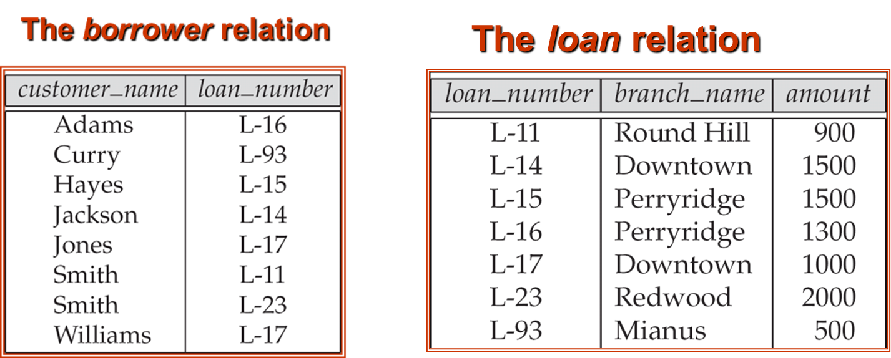
Example of BCNF Decomposition
Loan-schema = {loan-number, branch-name, amount}
Borrower-schema = {customer-name, loan-number}
Only trivial functional dependencies apply to
α → β is trivial (i.e., β ⊆ α)
loan-number → amount
loan-number → branch-name

Slide 152
Example of BCNF Decomposition
Often testing of a relation to see
if it satisfies BCNF can be simplified:
To check if a nontrivial dependency
α → β causes a violation of BCNF,
Compute α⁺ and verify that it includes all attributes of R;
That is, it is a superkey of R.

Slide 153
Example of BCNF Decomposition
Often testing of a relation to see if
it satisfies BCNF can be simplified:
• To check if a relation schema R is in BCNF,
it suffices to check only the dependencies
in the given set F for violation of BCNF,
Rather than check all dependencies in F+.

Slide 154
Example of BCNF Decomposition
Lending-schema =
(branch-name, branch-city, assets, customer-name, loan-number, amount)
branch-name → assets branch-city
loan-number → amount branch-name
candidate key
{loan-number, customer-name}.

Slide 155
Normalization Using Functional Dependencies
When we decompose a relation schema R with a set of functional dependencies F into R₁, R₂,.., R_{n} we want
Lossless-join decomposition: Otherwise decomposition would result in information loss.
No redundancy: The relations R_{i} preferably should be in either Boyce-Codd Normal Form or Third Normal Form.
Dependency preservation: Let F_{i} be the set of dependencies F⁺ that include only attributes in R_{i}.
Preferably the decomposition should be dependency preserving, that is, (F₁ ∪ F₂ ∪ … ∪ F_{n})⁺ = F⁺
Otherwise, checking updates for violation of functional dependencies may require computing joins, which is expensive.

Slide 156
Example
R = (A, B, C) F = {A → B, B → C)
Can be decomposed in two different ways
R₁ = (A, B), R₂ = (B, C)
Lossless-join decomposition:
R₁ ∩ R₂ = {B} and B → BC
Dependency preserving
R₁ = (A, B), R₂ = (A, C)
Lossless-join decomposition:
R₁ ∩ R₂ = {A} and A → AB
Not dependency preserving (cannot check B → C without computing R₁ R₂)

